Slide 1
Design and test UHV printer for drawing electrodes
Zhi hao
2024.8.2

Slide 2
Summer research project summary
Use the tip of the needle to dip the drawing line
Use a syringe to mark in the air
An attempt to line the glove box

Slide 3
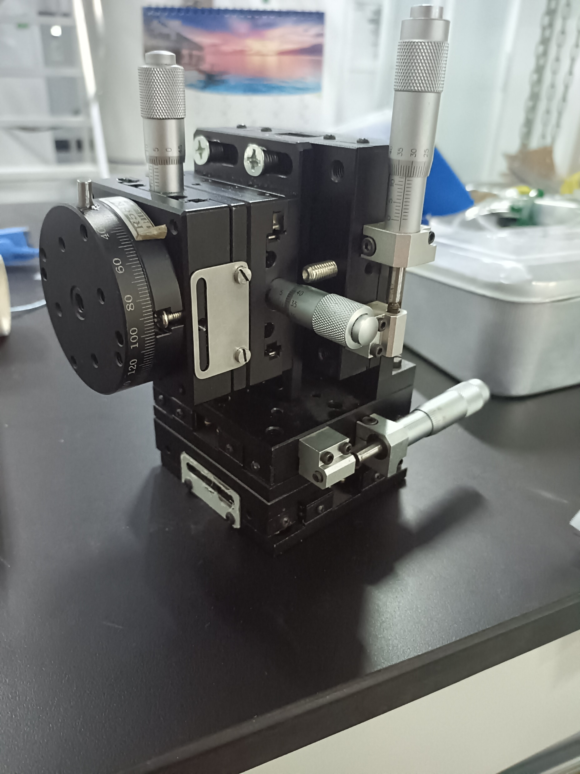
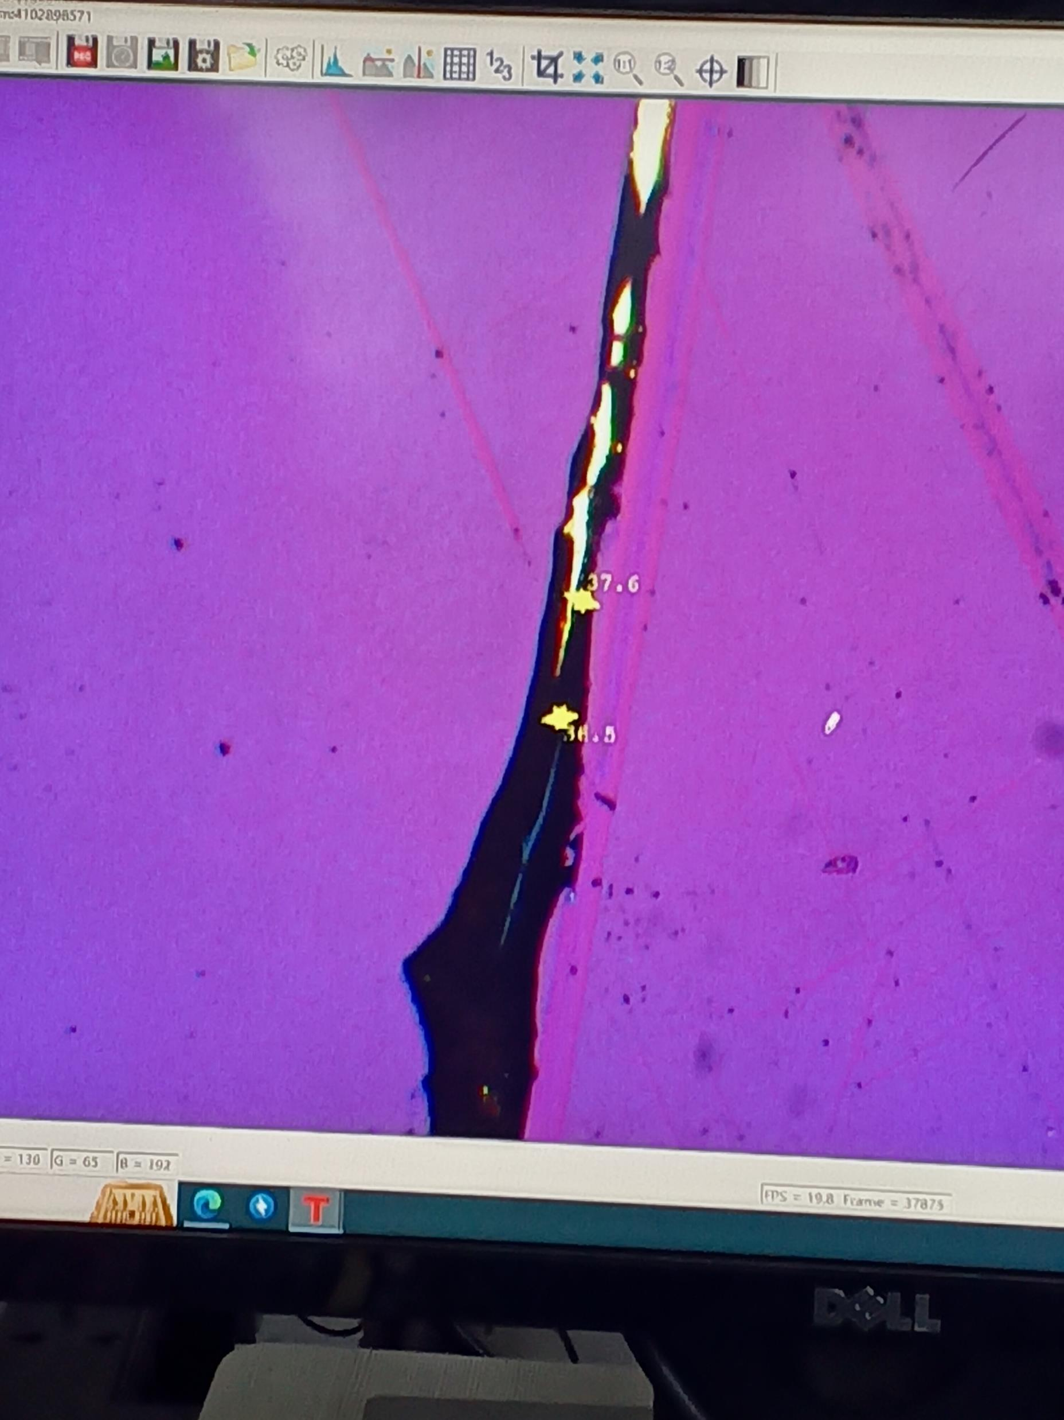
Dip the needle tip into the alloy
A simple displacement table was built.
Successfully draw the line in the air.
Can't draw any lines on the glove box.
The biggest advantage of pinpoint line drawing is that it is easy to implement, and it is easy to set up experimental platforms even under ultra-high vacuum.
At this time, I made a simple attempt with the tip of a needle, and after finding that I could not go, I tried to use the set of equipment that Tian thought

Slide 4
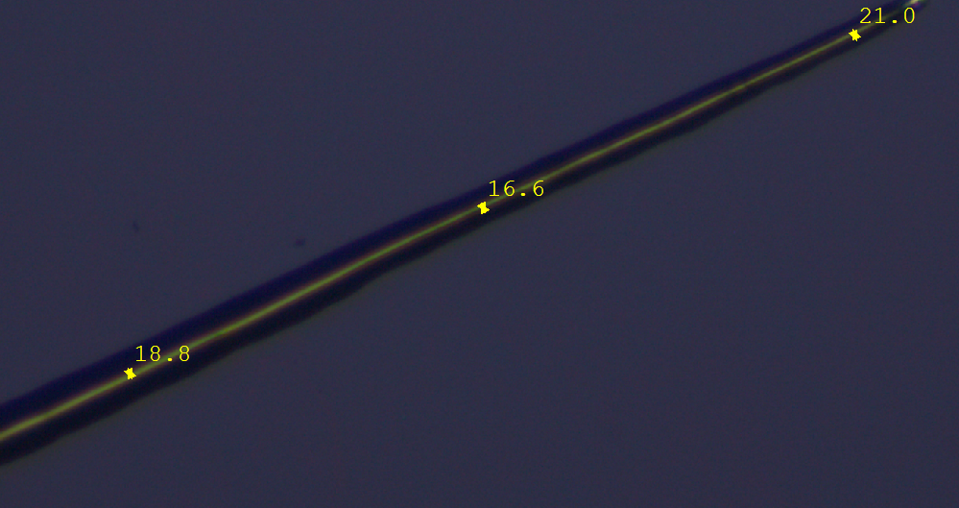
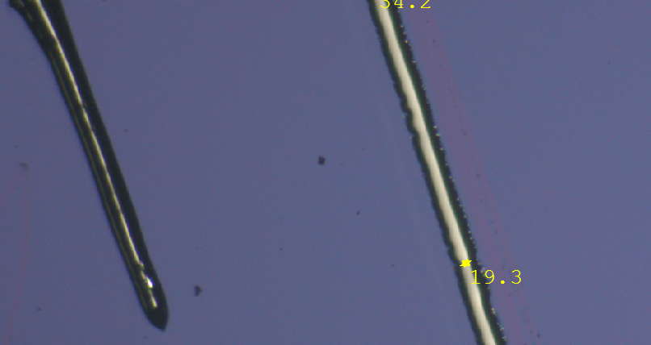
Use a syringe to mark in the air
Learn how to use this whole set of devices.
The difference between different marking methods is compared
Two methods of line drawing were tried, including pulse pressure and continuous pressure
Try the influence of different experimental parameters on the marking, including the thickness of the tip, the moving speed, and the tilt Angle
The program of measuring the trace of line drawing under different conditions is written
At this stage, we mainly buy a lot of experimental supplies, build experimental platforms, and conduct tests

Slide 5
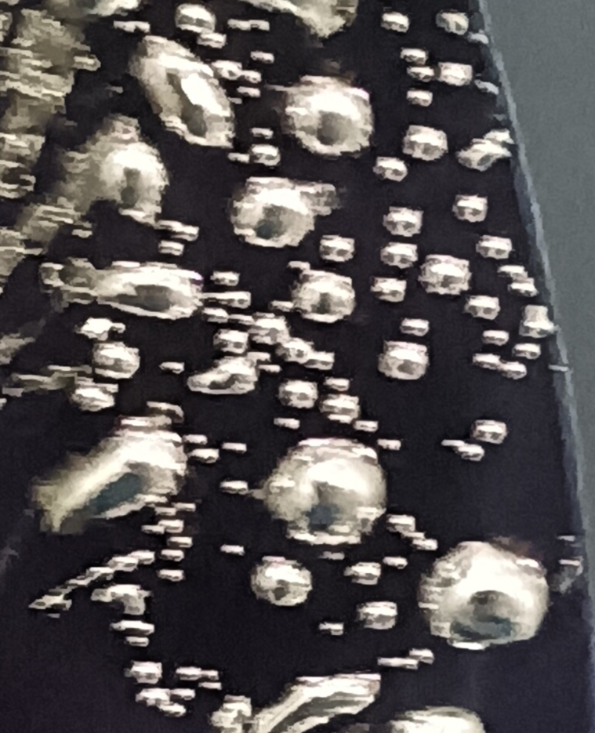
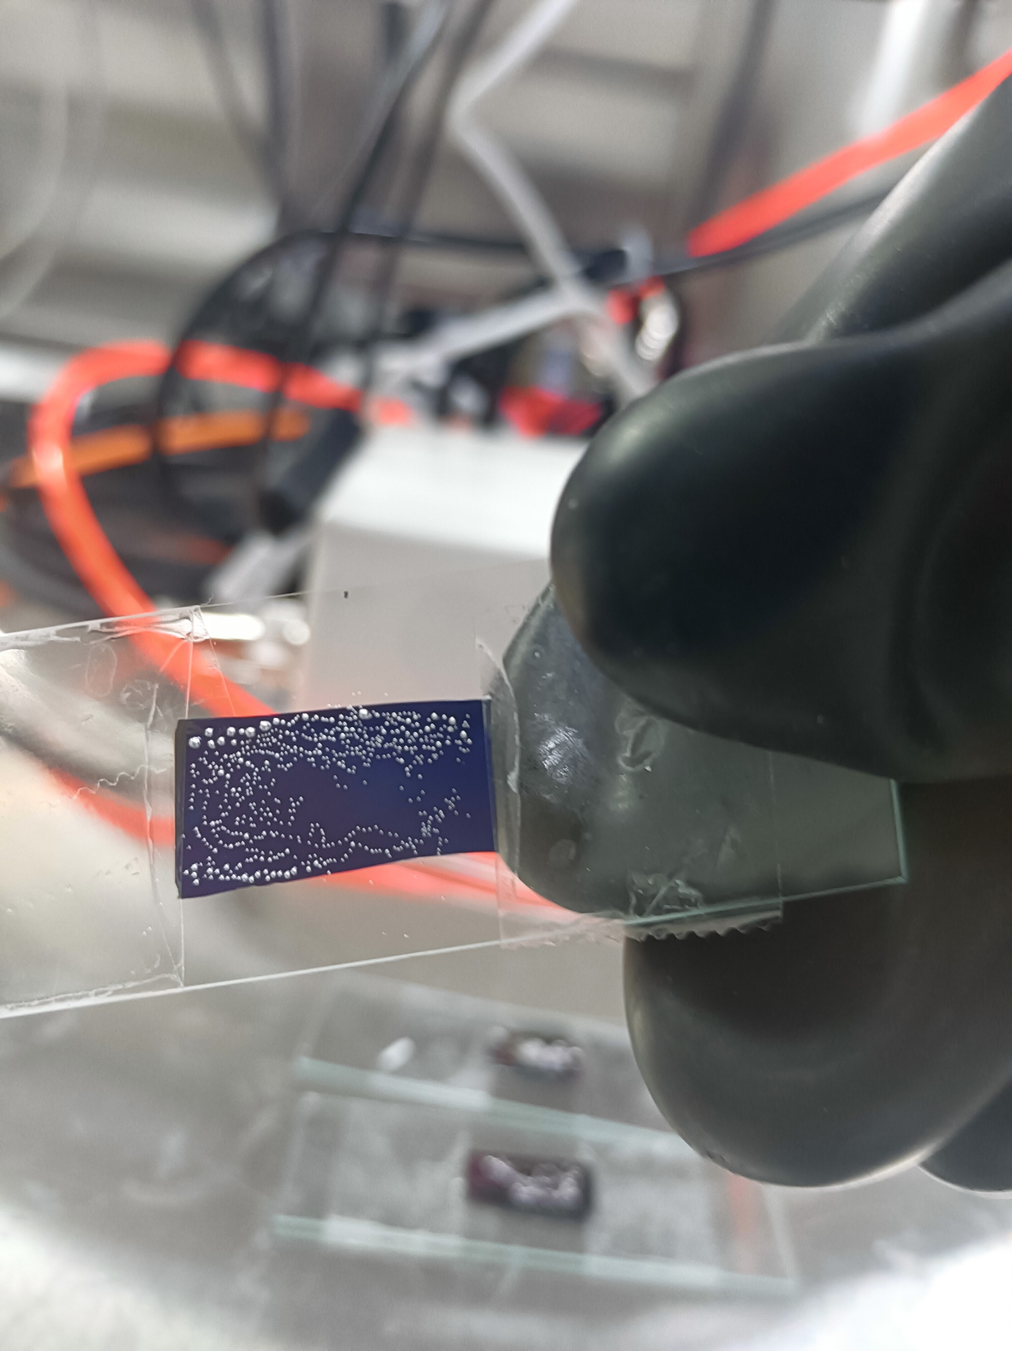
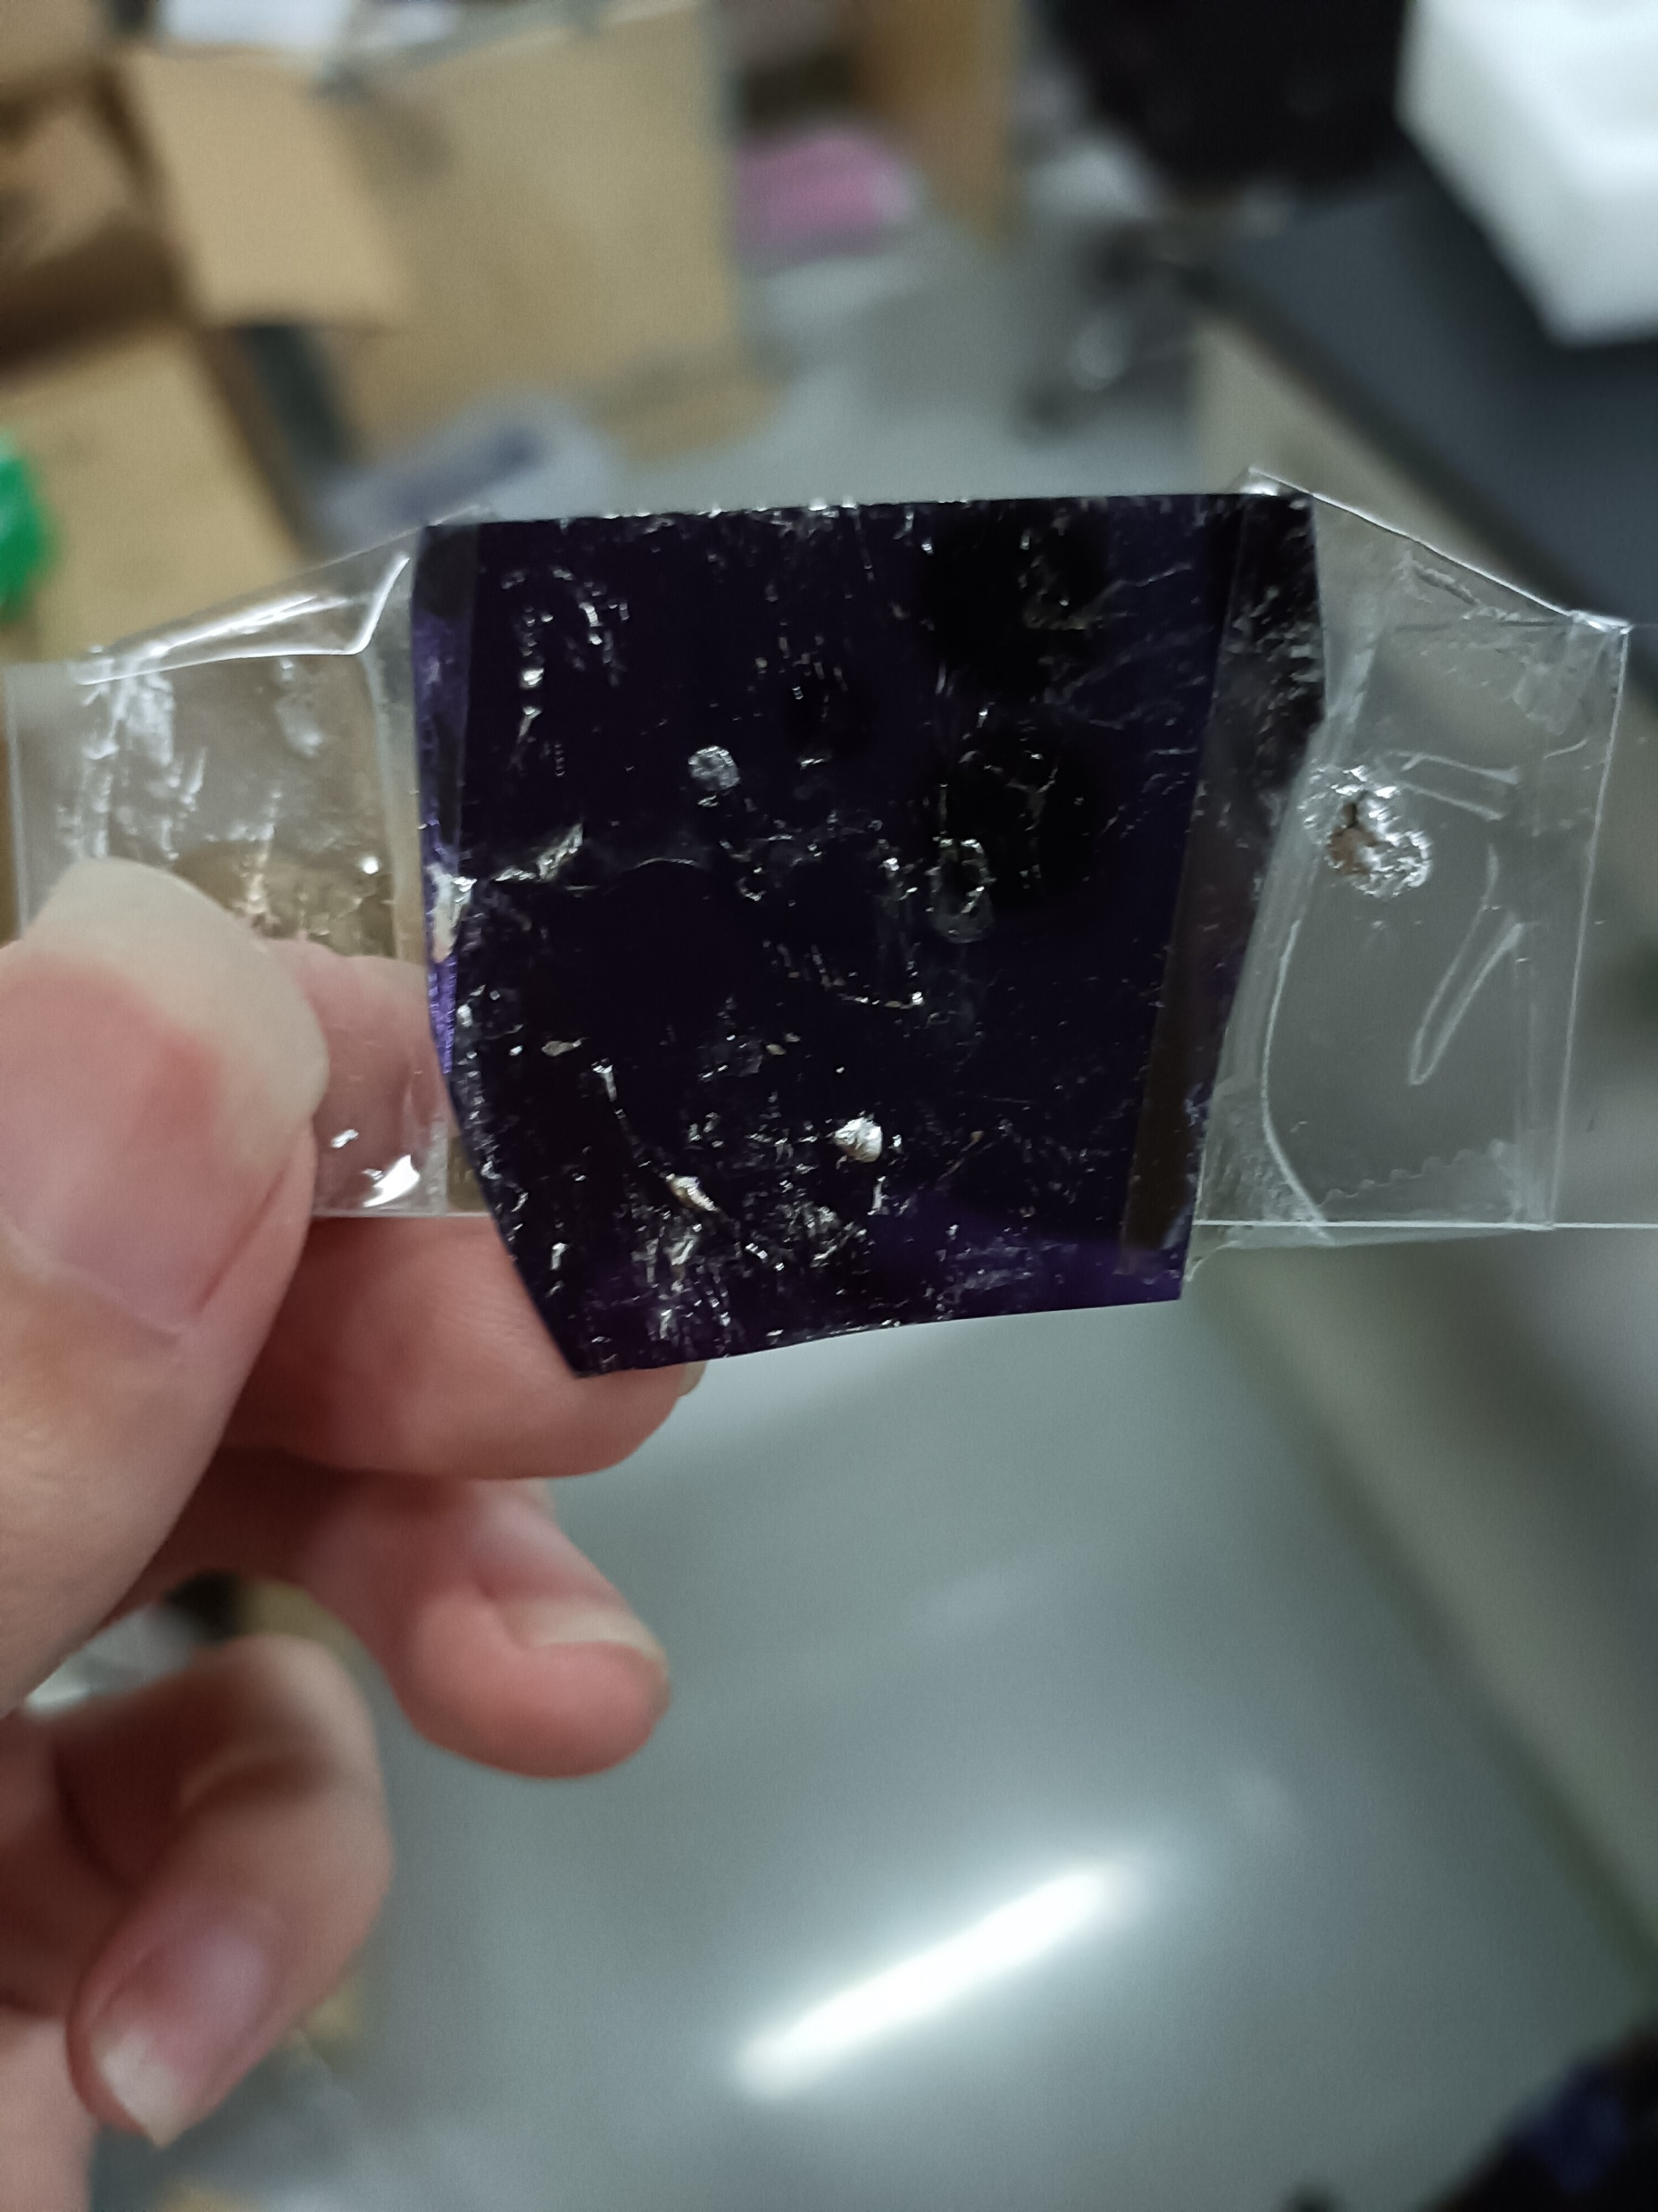
An attempt to line the glove box
A closed closed-loop gas path that can be charged and deflated is constructed
A platform for holding syringes was built
Customized a heater with a digital display and preparation of high melting point alloys
Attempts to line the glove box met with difficulties

Slide 6
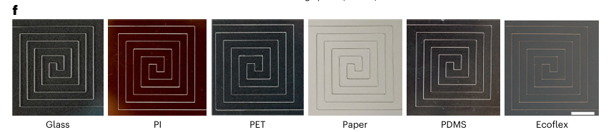
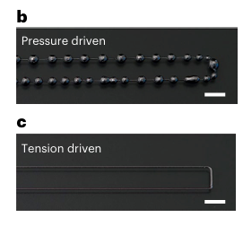
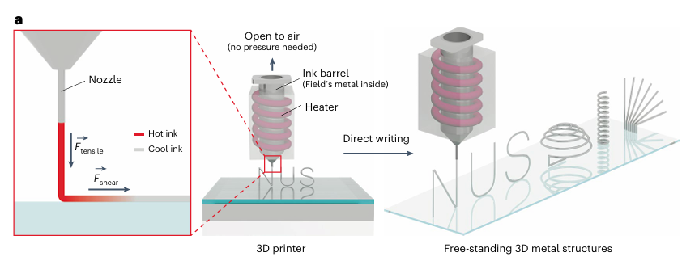
Some ideas about the project
Key:
Field’s metal—a eutectic alloy of 51.0 wt% indium, 32.5 wt% bismuth and 16.5 wt% tin—is an ideal material for 3D printing and a polydimethylsiloxane (PDMS) film was chosen as the substrate and the distance between the nozzle tip and substrate was fixed at 100 μm during every printing
Due to its high surface tension and low viscosity, pressure-driven DIW could not produce uniform metal wires on a substrate. Instead, a series of small beads were always observed to arise on printed metal wires before solidifying (Fig. 1b). The pressure applied to the ‘ink’ barrel is the main cause of undesired beading.
To initiate, the entire steel nozzle tube must be fully filled and wetted with molten metal before the first printing
After initiation, there should be a small amount of residue metal remaining on the nozzle tip. They are usually found as a cone ,instead of a typical meniscus in conventional DIW.
the metal may solidify and clog the nozzle if the printing speed is low. The nozzle ID could not exceed 260 μm; otherwise, the molten metal would flow out uncontrollably, as the resistance when the ink flows through a large nozzle tube is not enough to overcome gravity. If the nozzle ID is smaller than 210 μm, it is difficult to print continuous metal wires, since the resistance in a narrow nozzle is too large to be overcome by tension and gravity.

Slide 7
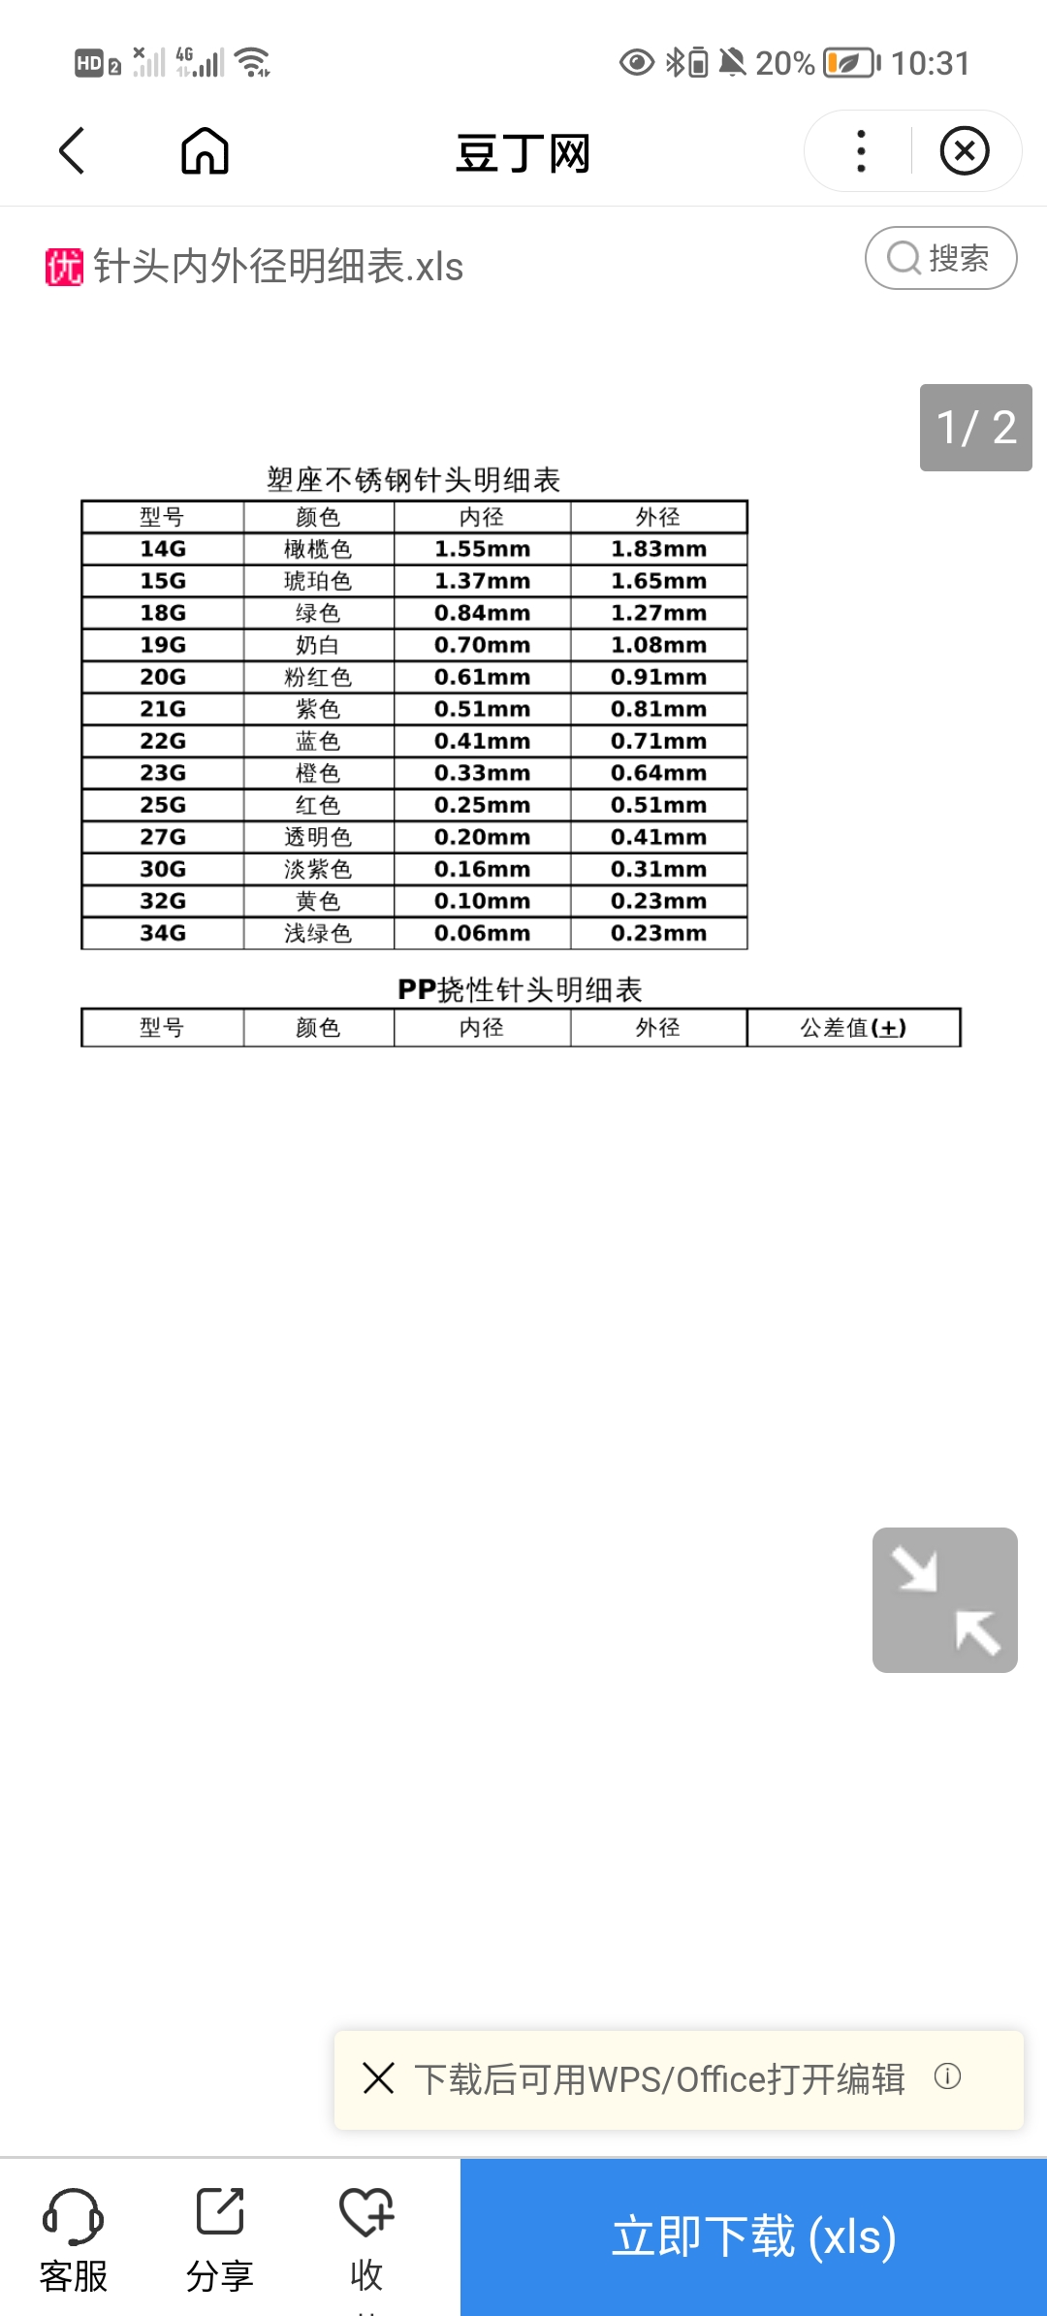
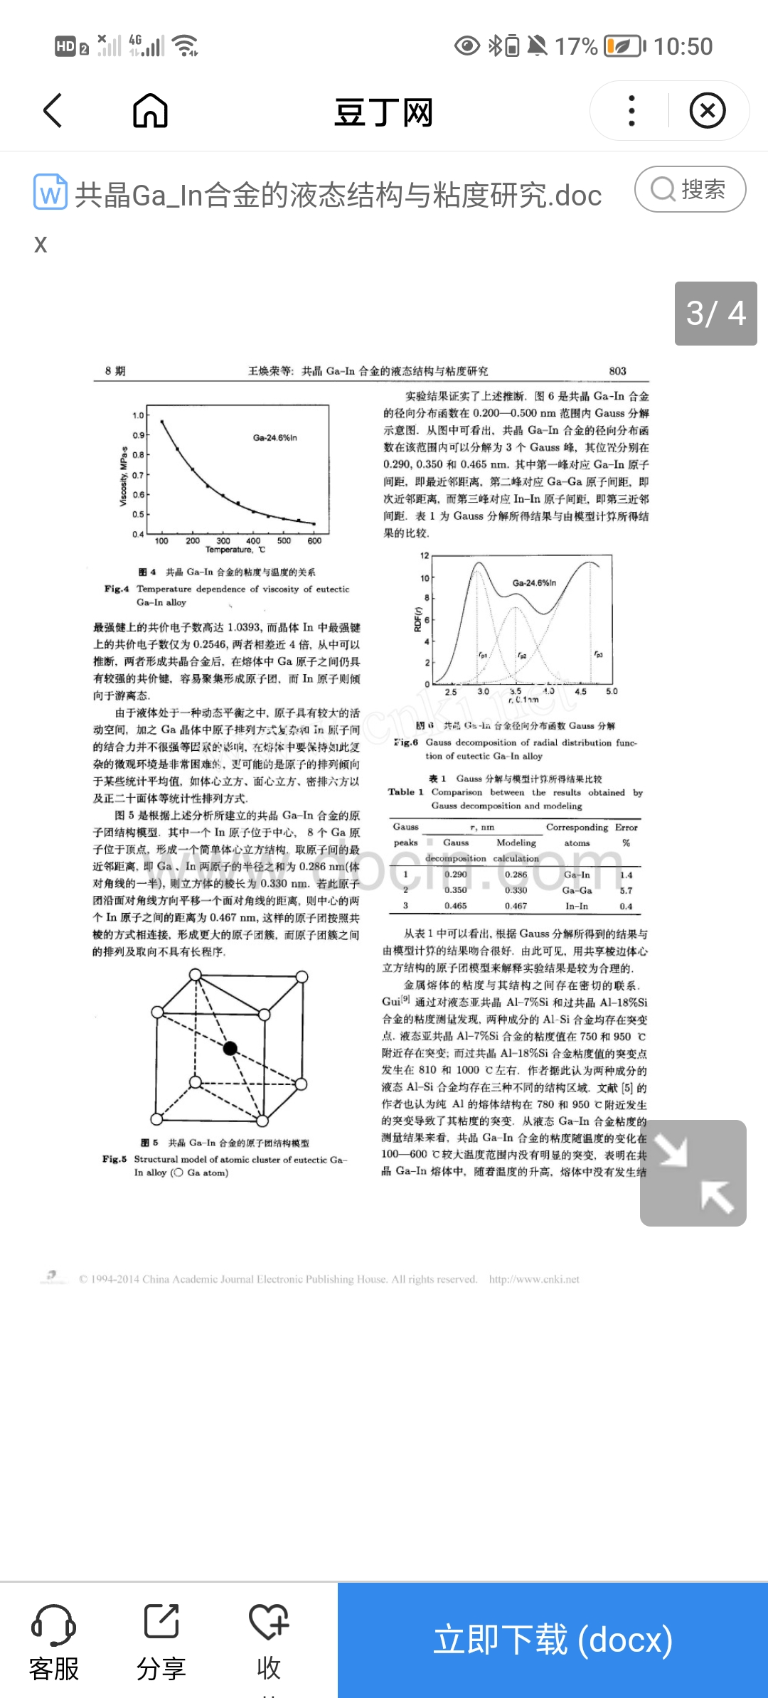
Some ideas about the project
Key:
the metal may solidify and clog the nozzle if the printing speed is low. The nozzle ID could not exceed 260 μm; otherwise, the molten metal would flow out uncontrollably, as the resistance when the ink flows through a large nozzle tube is not enough to overcome gravity. If the nozzle ID is smaller than 210 μm, it is difficult to print continuous metal wires, since the resistance in a narrow nozzle is too large to be overcome by tension and gravity.
Molten Field’s metal has a large surface tension of around 410 mN m−1 at 108 °C and a low viscosity of about 27 mPa s at 80 °C

Slide 8
Difference:
The metal of choice is different
The environment is different
The temperature control of heating is not precise enough
Selection of print parameters: the main consideration is the printing speed and the inner diameter of the needle
There was no infiltration, the drip cone on the tip of the needle
The needle is easily blocked

Slide 9
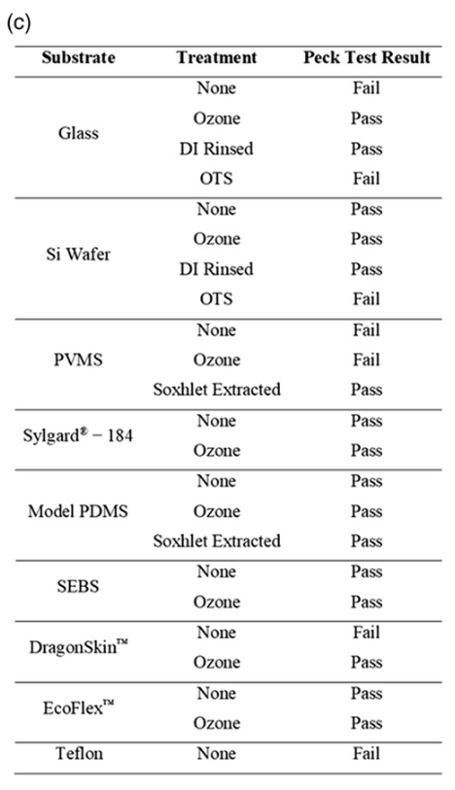
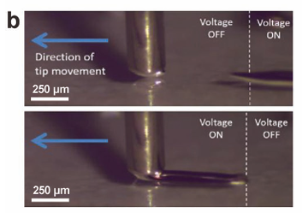
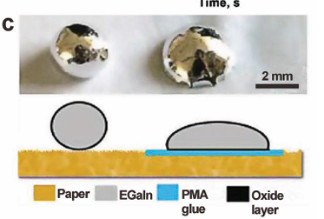
Some ideas
Watson et al. applied an AC voltage between the EGaIn electrode and the under lying substrate electrode, separated by a dielectric layer.The resulting electric field enhances the wettability of the liquid metal, effectively reducing the surface tension between the substrate and the liquid metal, and realizing the electrowetting assisted selective printing of liquid metal (Figure 7b).
The adhesion properties of EGaIn can also be changed by adding an adhesive layer. The wettability between the EGaIn and paper is poor, while the adhesion to polymethacrylates (PMA) is good, and PMA does not easily adhere to the paper. Guo et al. took advantage of this feature to print the required PMA patterns on paper, and then transfer printed EGaIn to pre pare paper electronics based on liquid metal transfer printing technology, as shown in Figure 7c.
Several substrates passed the peck test after cleaning by UV ozone treatment (exposure to an oxygen plasma also works). In addition to removing contaminants known to interfere with adhesion, these treatments can render surfaces hydrophilic. Hydrophilic surfaces should favor adhesion to the native oxide skin on the surface of EGaIn.

Slide 10
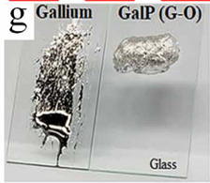
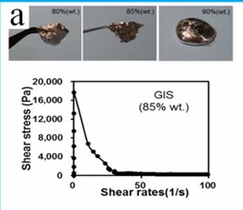
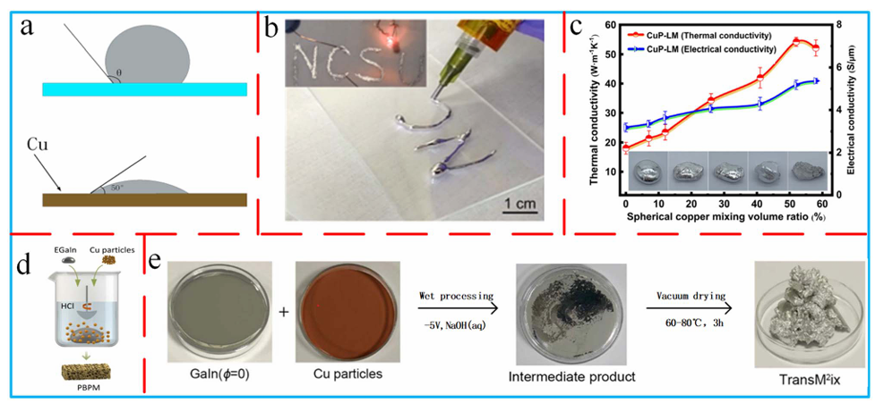
Some ideas
The copper particles are well inte grated into the liquid metal, but there is a non-uniform distri bution, which can be improved by grinding and ultrasonic treatment to obtain a paste with better properties, allowing it to be printed directly using a 3D printer (Fig. 6b) the electrical conductivity is enhanced by about 80%and thethermal conductivity by about 100% relative to the pure liquid metal. At the same time, the liquid metal has better adhesion to various surfaces and it possesses plasticity.(the existence of metal particles in the liquid metal is not stable, and it is easy to separate from the liquid metal under a strong Review external force)
Inorganic oxide nanomaterials. Inorganic oxide nanomaterials are not inherently conductive, so they are mixed with a liquid metal to reduce the surface tension mainly by forming metallic conductive pastes. Chang et al. mixed a liquid metal with SiO2 nanoparticles to produce a printable metal paste (GIS).
The addition of graphene to a liquid metal is the method most frequently utilized in 2D materials. the mixture's wettability and viscosity are proportional to the mass of graphene. When the lling ratio reaches 42vot%, the surface tension is reduced by 73% compared to pure gallium, and it also exhibits greater wettability. As the lling ratio increases, the mixture's viscosity steadily increases.

Slide 11
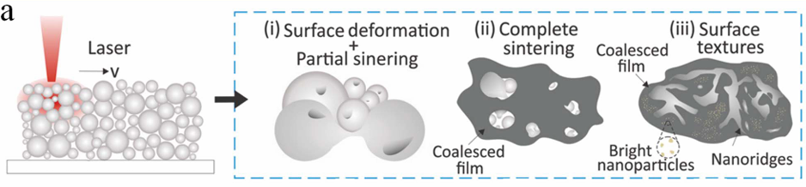
a liquid metal can be processed using the sintering technique.92,93 Laser sintering and heat sintering are the two most used sintering techniques. The liquid metal is more exible and electrically conductible being laser sintered, and the laser sintering process can be carefully regulated to produce high-resolution processing (Fig. 9a). Cho et al. used a laser to treat EGaIn and AgNWs. The treated EGaIn not only reduced the surface tension, but also combined with the AgNWs and wrapped on the surface of the silver nanowires to form a new structure.219 Sintering converts the liquid metal's interior from discrete droplets to a continuous network, improving electrical conductivity, and it is easy to prepare high resolution patterns.19

Slide 12
Brief summary
Change the gallium indium alloy:
Field’s metal
Metallic particles(Cu Ag)
GIS
Inorganic semiconductor nanomaterials
sintering technique
Improved adhesion of silicon wafers:
Temperature gradient
Alternating voltage
PMA

Slide 13
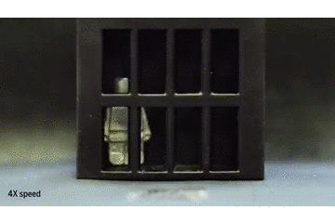
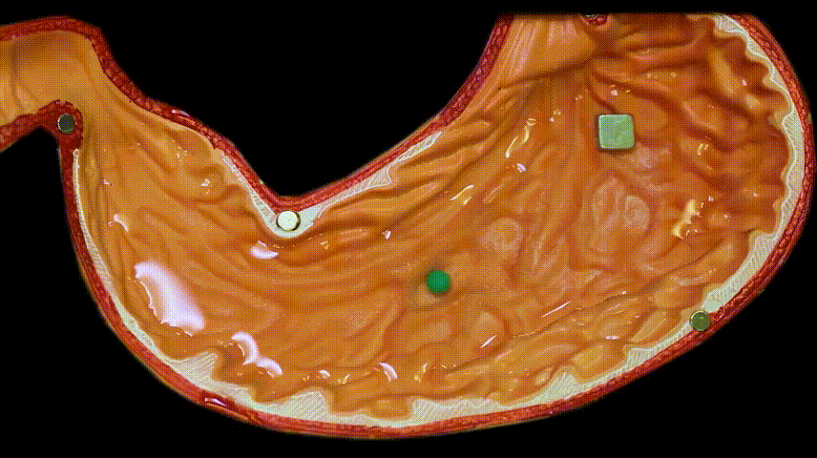
Liquid gold robot

Slide 14
Physical mechanism
The unique properties of liquid metals:
Deformability
conductivity
Magnetism(magnetic particles )
self-healing

Slide 15
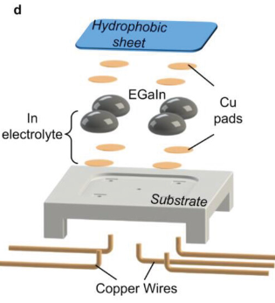
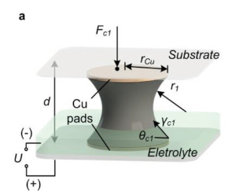
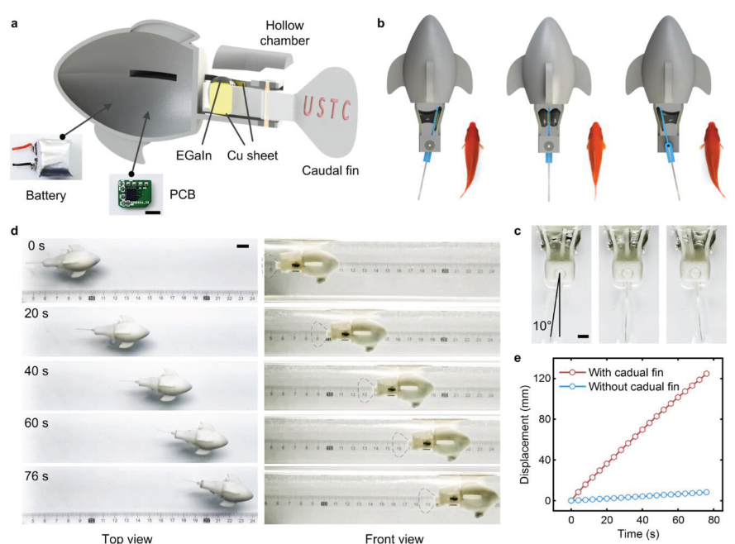
actuate
Without the presence of the oxide layer, Ga-based liquid metals have the largest interfacial tension (>600 mN m⁻¹, the value of which depends on composition and environment) of any known room-temperature liquid. And yet, such a large interfacial tension can be manipulated electrochemically to near zero upon the application of an oxidative potential in a solution. An electrically tunable interfacial tension provides an opportunity to create substantial changes in force, and thus, converting electrical energy into mechanical energy.

Slide 16
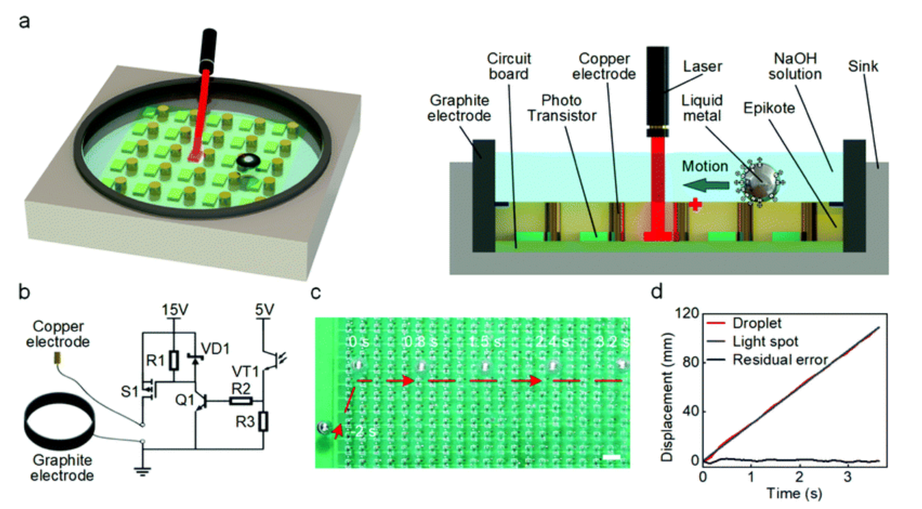
If the light sensor is not exposed to the laser spot, the p-MOSFET is in a cut-off state and the copper electrode is inactivated. When the optical sensor is irradiated by an infrared laser (wavelength of 940 nm and power density of 1 mW cm−2), the p-MOSFET will be turned on, which will induce an electrical potential gradient pointing toward the activated copper electrode. The application of an external potential gradient in the NaOH solution will change the distribution of charges in the electric double layer (EDL) on the interface between the solution and the surface of LM.36,44 Such a change of charge distribution will affect the local tension at the interface

Slide 17
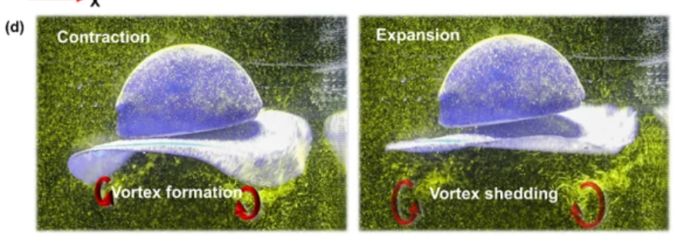

Slide 18
Thanks for listening

